Slide 1

215EXS2201 Design-Build Design and Development of a Smart Crutch System for Injury Rehabilitation
SCHOOL OF ELECTRONICS, ELECTRICAL AND BIOMEDICAL TECHNOLOGY
DEPARTMENT OF BIOMEDICAL ENGINEERING
Supervisor:
Dr.S.Sakthivel,
Associate Professor,
Department of Biomedical Engineering,
KARE.
Research Scholar:
TEAM:10
Nikhilsai (99240040748), 2nd Year, CSE
Kowshik Reddy(99240040758) ,2nd Year, CSE
Shanbu Sundar Reddy(99240040550),2nd Year ,CSE
Thilak (9924005117), 2nd Year, ECE

Slide 2
INTRODUCTION
Rehabilitation after lower limb injuries requires controlled weight bearing and proper gait assistance.
Traditional crutches provide only physical support, not monitoring.
Patients often face:
Incorrect weight application
Improper walking posture
Lack of recovery tracking
This leads to:
Delayed healing
Risk of re-injury
Need: A smart system that guides and monitors rehabilitation

Slide 3
Abstract:-
This project proposes an intelligent and personalized smart crutch system designed to support rehabilitation through real-time monitoring and feedback. The system integrates sensors to measure load and detect gait patterns, providing instant vibration-based alerts to users. A mobile application records data, generates progress reports, and enables remote monitoring. Machine learning techniques are incorporated to analyze rehabilitation patterns and predict recovery status. This system transforms a conventional crutch into a smart healthcare assistant, improving recovery safety, efficiency, and personalization.

Slide 4
Objective:-
To develop a smart crutch with load and motion sensing
To provide real-time feedback using vibration alerts
To design a mobile application for monitoring and tracking
To analyse rehabilitation using AI/ML techniques
To enable doctor and guardian monitoring
To improve safe and efficient recovery
To reduce the risk of incorrect weight bearing and secondary injuries
To improve rehabilitation efficiency and recovery time

Slide 5
Literature Review:-
Author(s) | Methodology | Journal Name | Year | Inference
García-Barrios et al. | Cognitive offloading model in human-AI systems | IEEE | 2026 | AI improves decision-making but depends on interaction design
Guo et al. | Shoe-based sensors + ML for gait analysis | IEEE TNSRE | 2025 | Accurate prediction but lacks real-time feedback and assistive support
Varghese et al. | IoT-based smart crutch with sensor monitoring | IJIRSET | 2024 | Enables remote monitoring but lacks AI-based analysis and real-time feedback
Naets et al. | Smart walker with multi-sensor monitoring | IEEE Access | 2022 | Effective in clinics but lacks portability and AI-based personalization

Slide 6
Author(s) | Methodology | Journal | Year | Inference
Mukherjee et al | Beta regression model for gait analysis | IEEE JBHI | 2025 | Accurate gait analysis but lacks real-time assistive feedback
Arcobelli et al | mHealth-based smart crutch with remote monitoring | Sensors | 2023 | Supports remote care but lacks AI analysis and real-time feedback
Sarkar et al | IoT-based smart crutch with e-care architecture | IEEE TENSYMP | 2020 | Enables remote monitoring but lacks AI analysis and real-time feedback
Yang et al | Multifunctional smart crutch for elderly monitoring | IEEE DASC | 2019 | Improves safety but lacks AI analysis and real-time feedback
Viegas et al | Load cells + optical sensors for walker monitoring | Sensors | 2018 | Accurate monitoring but lacks real-time feedback and AI integration
Chen et al | Instrumented smart crutches for rehab & exoskeleton support | IEEE BIOROB | 2018 | Improves assistive support but lacks AI analysis and real-time feedback
Kyritsis et al | Smart device-based gait recognition system | IEEE AI4I | 2018 | Enables gait analysis but lacks real-time feedback and assistive integration
Sugiyama et al | Crutch training system with fall simulation | IEEE SMC | 2018 | Improves training but lacks real-time monitoring and AI-based analysis

Slide 7
Existing Method Disadvantages :-
No real-time monitoring
No feedback system
No gait analysis
No recovery tracking
No AI-based insights
No remote doctor monitoring
Patients depend only on guesswork

Slide 8
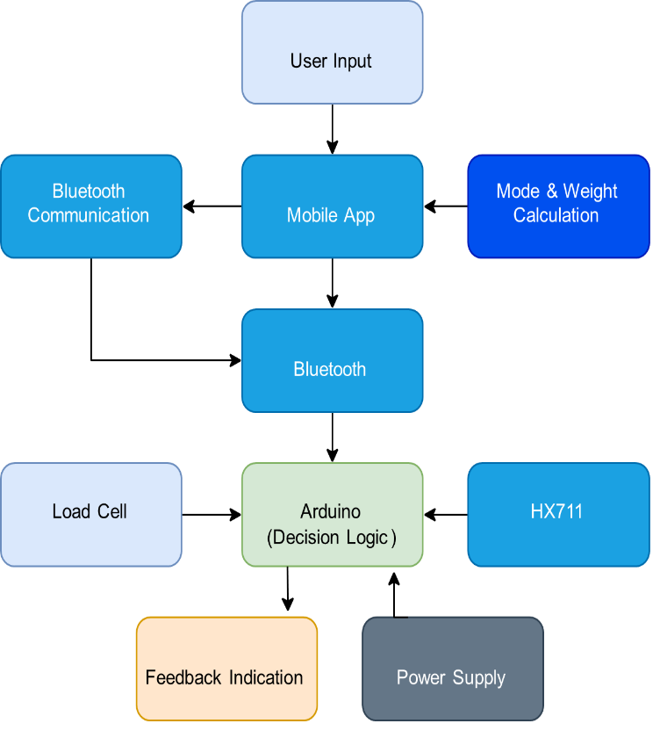
Proposed Method (Block Diagram):-

Slide 9
Methodology:-
Sensor data collection (Load + Motion)
Data processing using ESP32
Real-time transmission via Bluetooth
Data storage in mobile app
ML-based analysis
Feedback generation
Cloud synchronization

Slide 10
Explanation of Methodology:-
Load sensor measures applied weight
MPU6050 detects motion and gait
ESP32 processes sensor data
Bluetooth sends data to mobile app
App analyzes and stores data
ML predicts recovery status
Vibration alerts notify incorrect usage
Cloud enables remote monitoring

Slide 11
Future Work:-
Advanced AI prediction models
Real-time doctor dashboard
Voice assistance for patients
Clinical testing and validation
App development with cloud storage
Startup-level product development

Slide 12
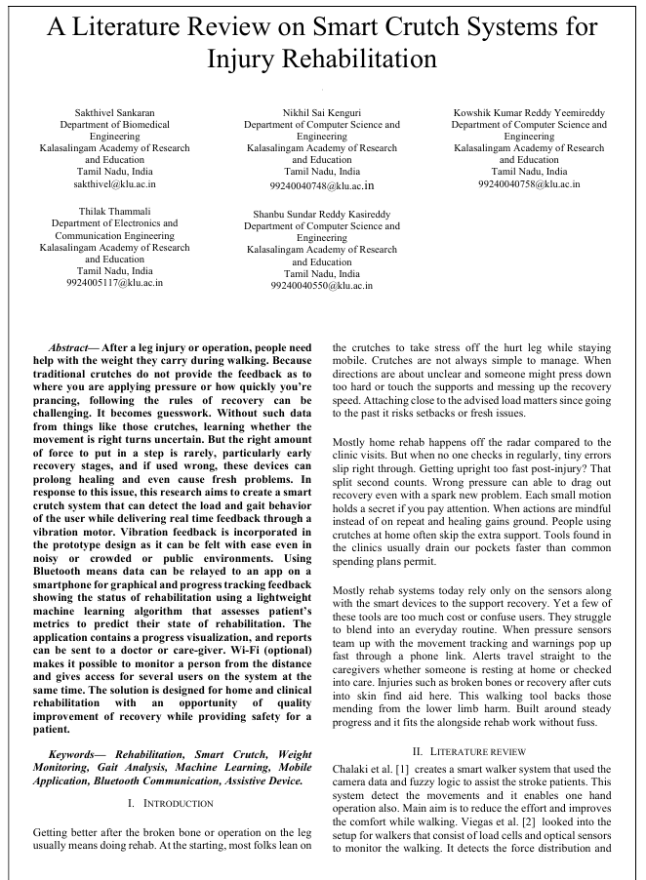
Paper Work:-

Slide 13
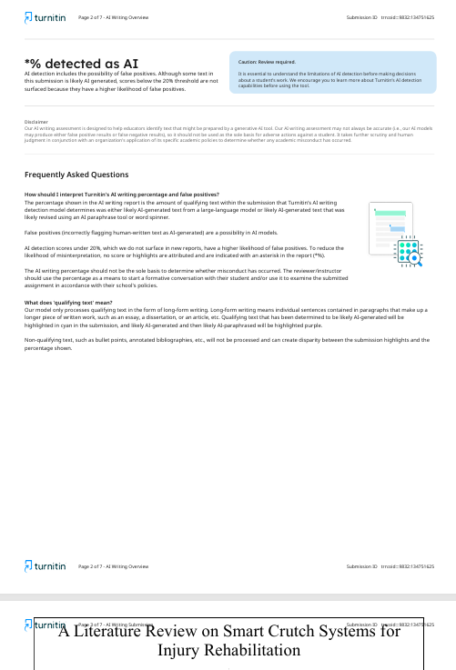
AI plagiarism:-

Slide 14
REFERENCE
[1] D. A. García-Barrios, “Epistemic partner or cognitive crutch: A conceptual model of cognitive offloading in human–artificial intelligence collaboration,” IEEE, pp. 7–8, Jan. 2026, doi: 10.1109/MIC.2025.3626694.
[2] R. Varghese, Ananya R., N. V., Sagarika T. H., and Sanjana N., “Smart crutches using IOT,” Int. J. Innov. Res. Sci. Eng. Technol. (IJIRSET), vol. 13, no. 8, pp. 15549-15551, Aug. 2024.
[5] M. Mukherjee, A. I. Faisal, N. Balakrishnan, S. Kumar, and M. J. Deen, “An inferential model for understanding the effects of demographic and gait factors and their interactions on the human gait index: A beta regression approach,” IEEE Journal of Biomedical and Health Informatics, vol. 29, no. 10, Oct. 2025.
[6] V. A. Arcobelli, M. Zauli, G. Galteri, L. Cristofolini, L. Chiari, A. Cappello and L. De Marchi,“mCrutch: A Novel m-Health Approach Supporting Continuity of Care,” Sensors, vol. 23, no. 8, 2023, doi: 10.3390/s23084151.
[7] P. P. Sarkar, M. A. Tohin, M. A. Khaled, and M. S. Rahman, “Implementation of an instrumented crutch with scalable E-care architecture using IoT,” in Proc. 2020 IEEE Region 10 Symposium (TENSYMP), 2020, pp. 242-245.
[8] R. Sugiyama, N. Tsuda, N. Kato, and Y. Nomura, “Modelling of crutch walk training system with falling sensation device,” in Proc. 2018 IEEE Int. Conf. Systems, Man, and Cybernetics (SMC), 2018.
[3] Z. Guo, Y. Li, Y. Wang, H. Liu, R. Guo, J. Ma, X. Wu, D. Jiang, T.Ren, “Intelligent diagnosis and predictive rehabilitation assessment of chronic ankle instability using shoe-integrated sensor system,” IEEE Trans. Neural Syst. Rehabil. Eng., vol. 33, 2025.
[4] B. Naets, Z. Guo, Y. Li, Y. Wang, H. Liu, J. Ma, X. Wu, T. Ren, D. Jiang, and R. Guo, “Smart walker design for clinical rehabilitation,” IEEE,2022, doi:10.1109/ACCESS.2022.2973815.

Slide 15
THANK YOU

